Slide 1
Project development and preparation for submission
GIANFRANCO GADALETA
JOINT SECRETARIAT COORDINATOR

Slide 2
Project intervention logic
The applicants should demonstrate through the intervention logic that it:
One objective
One intervention field
Output and r.i.
targets one single Programme’s specific objective
one Intervention field (in case of project which fits in more than one I.F. the one with the biggest budget shall be selected)
contributes to the respective Programme output and result indicator
Logic sequence
links in a logic sequence the project activities and outputs to the specific objective targeted

Slide 3
Objectives, expected results and outputs
The most important steps in the development of the project proposal are
to define the objectives
the expected results clearly and precisely

Slide 4
Development of a project proposal
A satisfactory project proposal shall include:
A convincing project idea
A robust partnership
A dedicated Communication Strategy

Slide 5
Development of a project proposal: partnership
The partnership is crucial in a cross-border cooperation project.
The description of the partnership should highlight the following:
Description of each beneficiary;
Lead Beneficiary’s Role;
Complementarity of the beneficiaries;
Joint character of the project.

Slide 6
Development of a project proposal: communication strategy
The need for a communication Strategy for individual projects derives from the Programme’s communication objectives. Applicants are invited to consult the Programme (especially Section 5) and the Annex 25 Communication Guide for Project Beneficiaries of the Call, before drafting the project’s communication Strategy.

Slide 7
Development of a project proposal: communication strategy
It is mandatory for the partnership identify a professional communication manager with professional skills for the communication activities and social media.

Slide 8
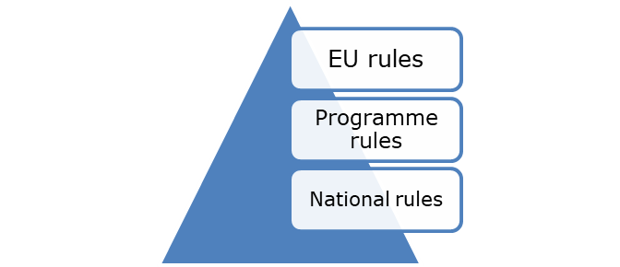
Eligibility
Expenditures-Regulatory framework
01
02
03
04
Development of a project proposal: communication strategy
The application of the rules on the eligibility of the expenditures follow the below ranking:
A
B
C
Programme eligibility rules as set out in this Manual and detailed in each call for proposals
National legislation eligibility rules. They apply only for matters not covered by EU and Programme eligibility rules
EU rules on eligibility as set out in the CPR, ERDF and Interreg Regulations

Slide 9
Eligibility
Expenditures-Regulatory framework
01
02
03
04
Development of a project proposal: communication strategy
All applicable EU and national rules on other than eligibility of expenditure matters, (e.g. rules on public procurement) should be followed by the beneficiaries considering the stricter applicable rule.

Slide 10
Eligibility: General Rules of Eligibility
Expenditure have to be paid for and made by beneficiaries and to be:
compliant with the conditions and the objectives of approved projects
Recorded in the accounting system of the beneficiary
supported by invoices (or accounting documents of equivalent probative value), bank extraits, etc.
Justified in the reporting documents detailing the connection between the expenditure incurred and the related project activities/output/deliverables

Slide 11
Eligibility
General rules
01
02
03
04
Development of a project proposal: communication strategy
Period of Eligibility => between 1 January 2021 and 31 December 2029
Implementation Area of an Operation => within the area covered by the Programme except duly justified activities approved by the MA, which shall be included in a separate WP6

Slide 12
Eligibility
Type of costs
01
02
03
04
Development of a project proposal: communication strategy
1. Real costs
The project beneficiaries commit and pay the expenditures. The incurred expenditure is backed by invoices or any other equivalent accounting documents. The registration in the accounting system is based on the delivery of works, services or supplies
2. Simplified cost options (SCOs)
Under the Programme the following SCOs are available according to Article 54 of the Regulation (EU) 2021/1060:
flat rate for the calculation of staff costs
flat rate for the calculation of office and administrative expenditure
flat rate for the calculation of travel and accommodation expenditure

Slide 13
01
02
03
04
Development of a project proposal: communication strategy
Project expenditures/ budget lines
Staff costs
Office and
administrative costs
Travel and accomodation
costs
External expertise and services costs
Equipment costs
Infrastructure costs

Slide 14
01
02
03
04
Staff costs
Staff costs shall consist of gross employment costs of staff employed by the Interreg beneficiary in one of the following ways:
full time,
part-time with a fixed percentage of time worked per month,
part-time with a flexible number of hours worked per month, or on an hourly basis.
OPTIONS apply to the 1st Call:
Real costs;
As a flat rate of up to 20 % of the direct costs other than the direct staff costs of that operation.
OPTIONS:
The option selected for the calculation of staff costs applies on a beneficiary level for the entire project period.
This option must be declared in the Application form in the Partnership Section.

Slide 15
01
02
03
04
Office and Administrative costs
The following options for calculating Office and administrative costs are available under the 1st Call:
Real costs
Simplified costs – fixed percentage of the gross employment cost (Flat rate), up to 15 % of eligible direct staff costs.
In both cases – use of real costs or simplified costs, office and administrative costs cannot exceed the 4% of the total beneficiary’s budget.
The option selected applies on a beneficiary level for the entire project period.
This must be declared in the Application form in the Partnership Section.

Slide 16
01
02
03
04
Travel and Accommodation costs
Travel and accommodation costs are eligible, regardless such costs are incurred and paid inside or outside the Programme area.
A. Real cost
B. Flat rate of up to 15 % of the direct staff costs (simplified costs).
The option selected applies on a beneficiary level for the entire project period.
This must be declared in the Application form in the Partnership Section.

Slide 17
01
02
03
04
External expertise and services costs
When awarding external expertise and service contracts, all ERDF project beneficiaries must ensure that EU and national rules on public procurement are respected, in accordance with the amount of the contract. All contracts must comply with the basic principles of transparency, non-discrimination and equal treatment.

Slide 18
01
02
03
04
Equipment costs
Costs for the purchasing of equipment are eligible under the condition that the equipment is necessary for the project implementation and is foreseen in the approved Application Form. There should be an analytical description of the technical specifications and the relative costing (Justification of the budget, Maturity Sheet).
The selection of the suppliers for the purchasing of any equipment item shall comply with the relevant public procurement rules in force.

Slide 19
01
02
03
04
Infrastructure and works
Expenditures for infrastructure and works are eligible under the condition that the cross-border impact of the investment is demonstrated and the activity has been approved in the Application Form. The contractor cannot be a beneficiary of the project.
The description of these expenditures should be provided by ”Bill of Quantities and Costs” based on technical studies and/or appropriate justification according to national legal framework. The latter will be described in the “Maturity Sheet” and the documentation will be attached to the Application Form in MIS.
Infrastructure located outside the Programme area, even if it is directly related to the project either for the development or for implementation, shall not be eligible.

Slide 20
01
02
03
04
Preparation Costs
Costs within the budget lines “staff costs, travel and accommodation costs and external expertise and services”, which have been incurred for the preparation of the project, are eligible for funding
CONDITIONS:
If the services or activities were implemented and there is at least a commitment decision for them between 1st of January 2021 and the date of submission of the Application Form. The related payments should be made and should be included preferably in the first request for verification.
If they show direct connection to the approved project and are included in the Application Form in the Deliverable 1X1 “Preparation Activities” (where X is the number of the beneficiary).
If they do not exceed the amount of €30.000 at project level

Slide 21
01
02
03
04
Management Costs
Management costs should be included only in WP1 of the Application Form and concern the costs related to the administrative activities to be implemented for the efficient management and coordination of the project.
The management costs of each project beneficiary should not exceed 10% of the total approved beneficiary’s budget. For the Lead Beneficiary this percentage shall be limited to 15% of its budget.
The following WP1 costs are not calculated in the above percentage limits:
Deliverable 1 X 1 “Preparation Activities” (where X is the number of the beneficiary).
FLC fees (applicable for Italian beneficiaries).

Slide 22
01
02
03
04
Communication Costs
‘Communication’ costs should be included only in WP2 of the Application Form and describe the actions for carrying out the external communication of the project efforts and outputs, dissemination of results, etc. The WP2 budget cannot exceed the 15% of the total project budget, without limits at beneficiary level.

Slide 23
01
02
03
04
Development of a project proposal: communication strategy
Justification of Budget (JoB)
WP 1
Management
costs
WP 2 Communication costs
WP3
Technical
WP
WP4
Technical
WP
WP5
Technical
WP
WP6
Activities to be implemented outside the Programme (otherwise it is not used)

Slide 24
01
02
03
04
PROJECT DETAILED DESCRIPTION
Project detailed description is filled on the MIS in the AF section ‘Additional Information’
Max characters per each field are the ones allowed by MIS

Slide 25
01
02
03
04
Development of a project proposal: communication strategy
Justification of Budget (JoB)
MAX 5 DELIVERABLES PER WORK PACKAGE

Slide 26
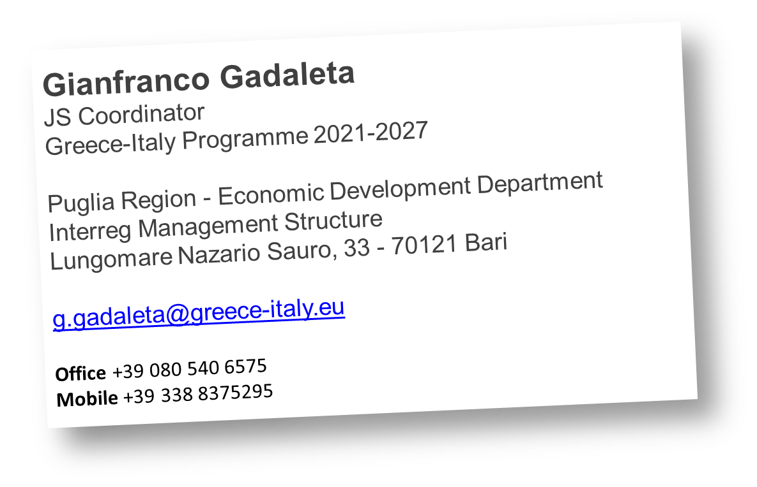
Thanks for the attention

