Slide 1
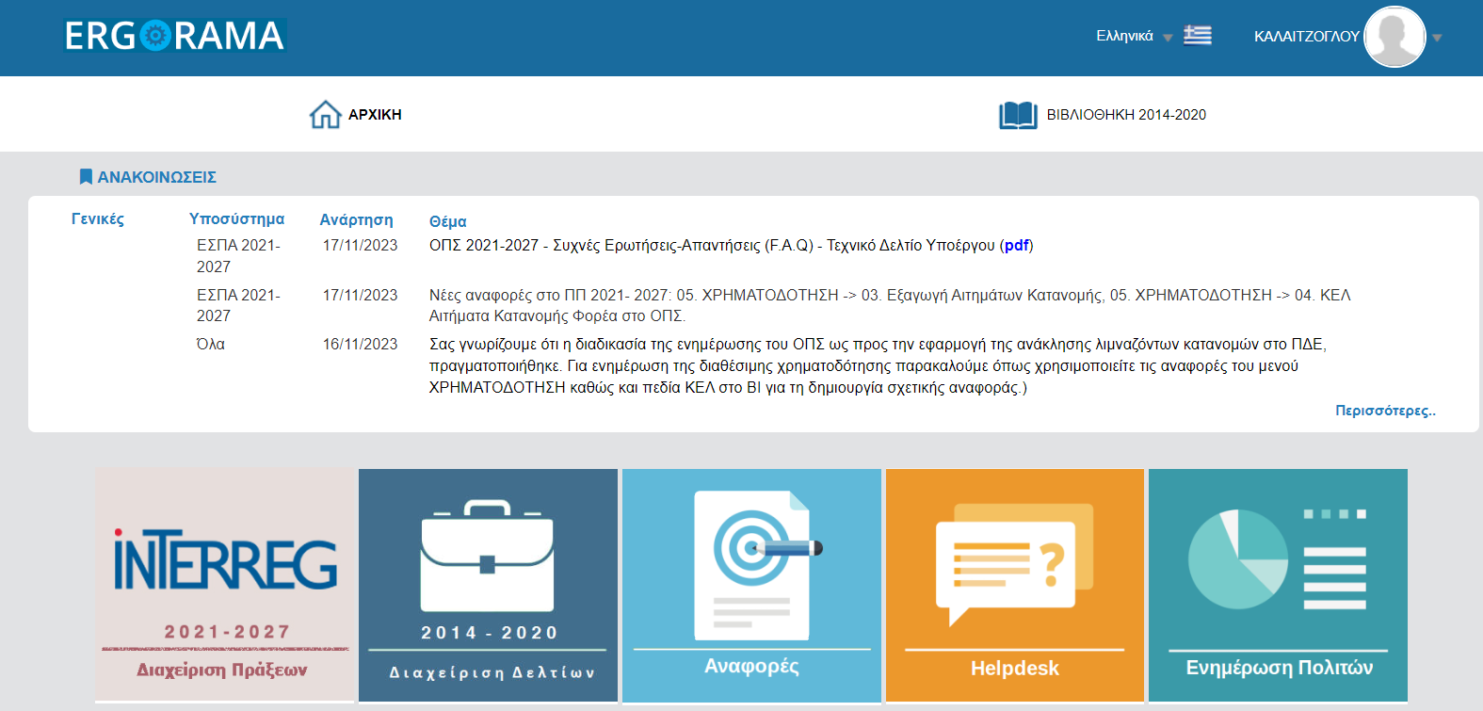
MANAGING AUTHORITH
“INTERREG 2021 -2027”
Application Form Submission
Phase B
Ioanna Kalaitzoglou - Unit Α
04/10/2024

Slide 2
Registry of organizations - MIS
https://www.ops.gr/Ergorama/fileUploads/ypostiriksi/kodikopoiisi/espa/foreis.xls

Slide 3
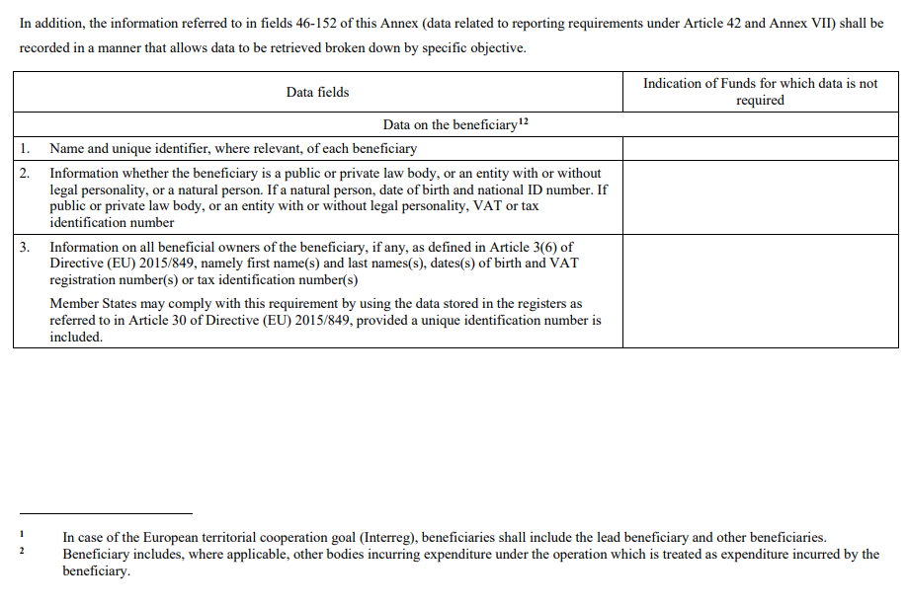
EC Regulation 2021/1060 24/06/2024 Annex XVII
https://eur-lex.europa.eu/legal-content/EN/TXT/PDF/?uri=CELEX:32021R1060

Slide 4
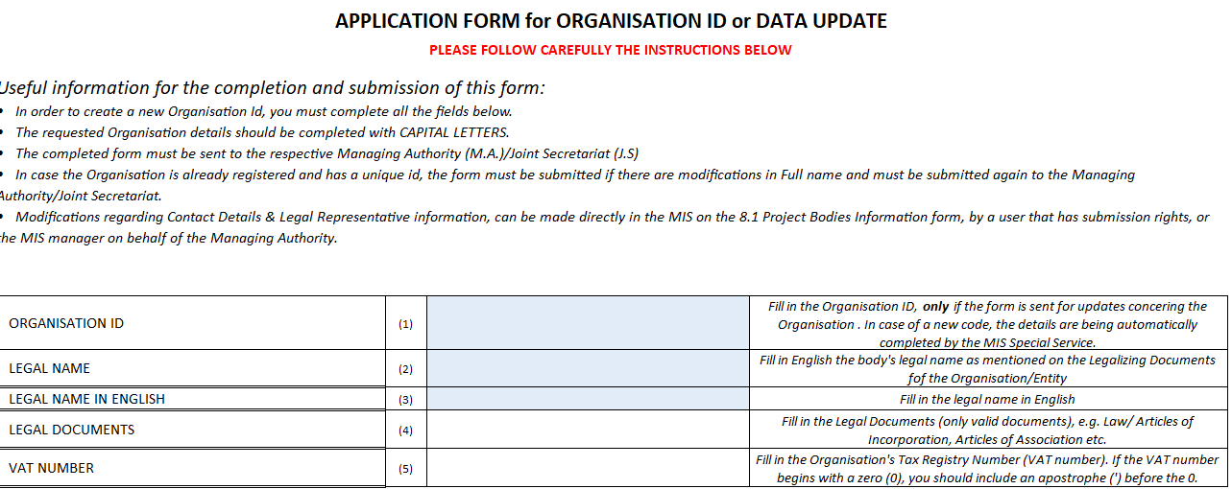
Organization’s Registration* in MIS
https://www.ops.gr/Ergorama/fileUploads/ypostiriksi/kodikopoiisi/purinas/entipo_foreis.xls

Slide 5
Organization’s Registration* in MIS
Joint Secretariat
info@greece-italy.eu
Beneficiary
ORGANISATION ID 900300500

Slide 6
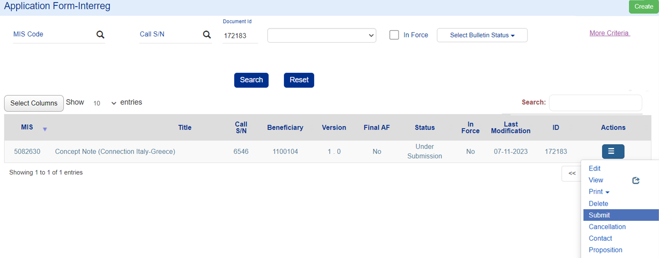
Electronic Submission of the Application Form

Slide 7
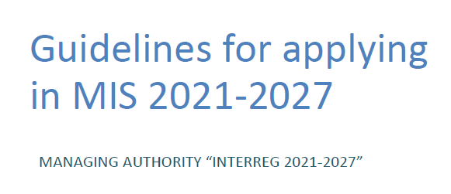
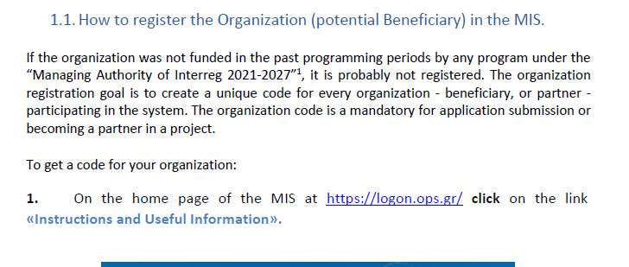
New User Account for access in MIS
https://interreg.gr/wp-content/uploads/2024/09/16.Guidelines-for-applying-in-MIS-2021-2027_V3.pdf

Slide 8
Creating a User Account
https://interreg.gr/wp-content/uploads/2024/06/SignUp_MIS_Ben.mp4

Slide 9
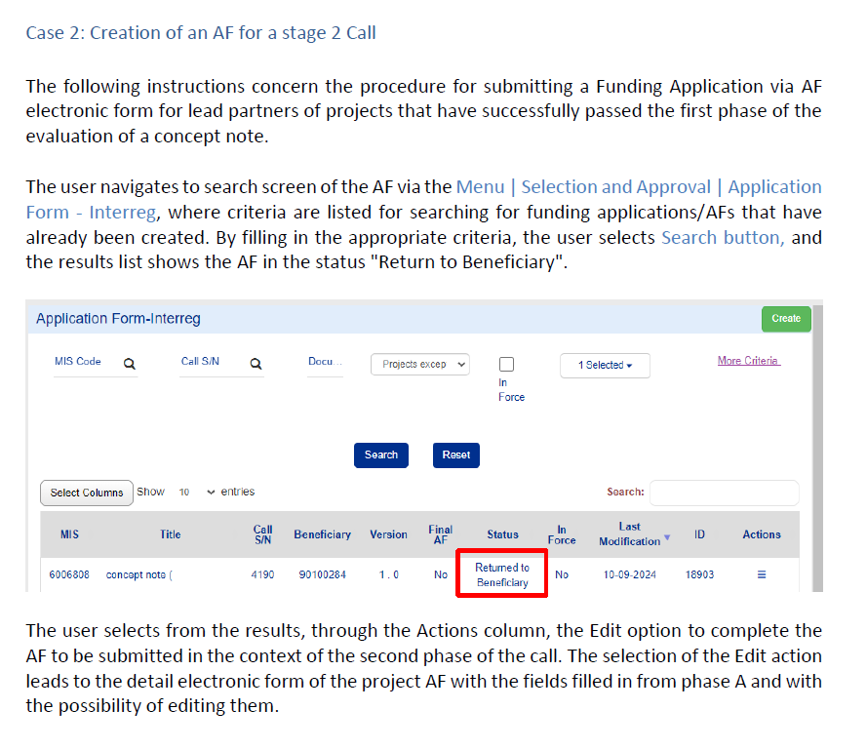
GUIDELINES Application Form Submission Phase B
https://interreg.gr/wp-content/uploads/2024/10/16.Guidelines-for-applying-in-MIS-2021-2027_V3.pdf

Slide 10
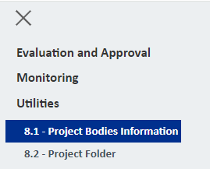
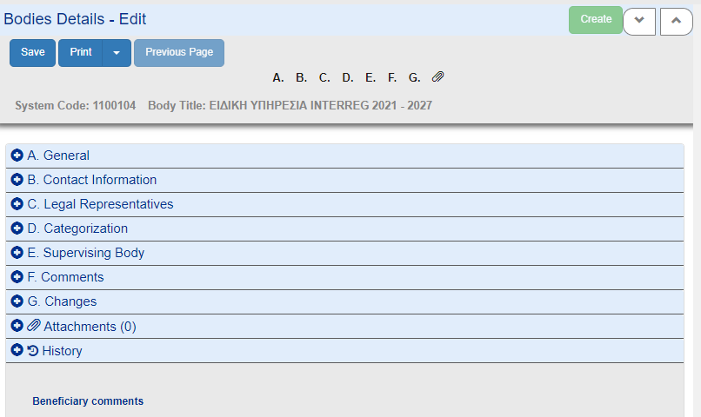
Update Project Body Details

Slide 11
General Information
Contact details
Legal Representatives
Attachments
Form Submission Role is required.
Submission of the fully registered xls file to the JS is required (Beneficial Owners details are registered by the Beneficiary).
To change the legal representative the user selects Add and fills in the details in the pop-up window. Form Submission Role is required.
Documentation upload is mandatory (see Annex A). Form Submission Role is required.

Slide 12
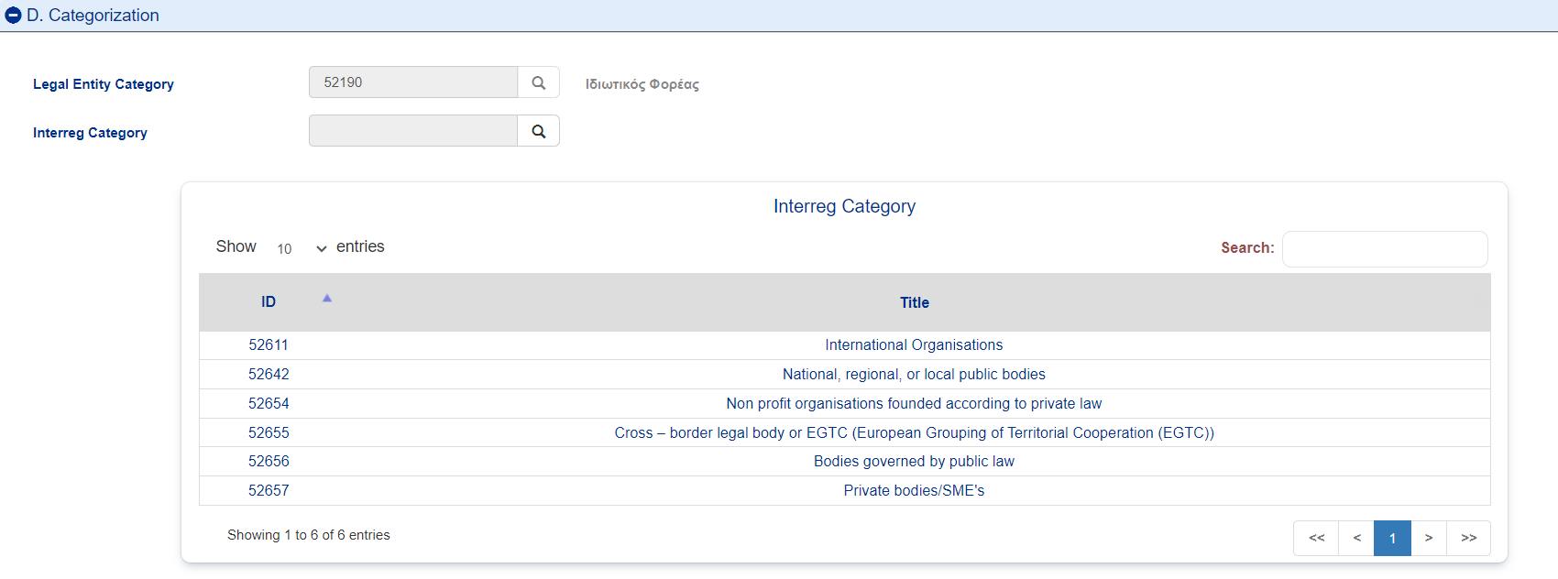
Organization Categorisation

Slide 13
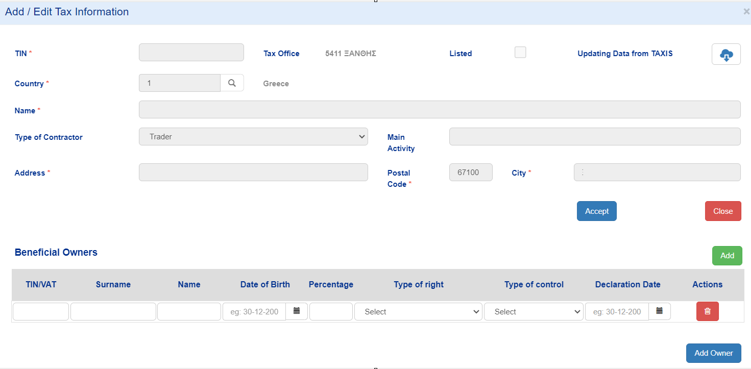
Beneficial Owners data registration

Slide 14
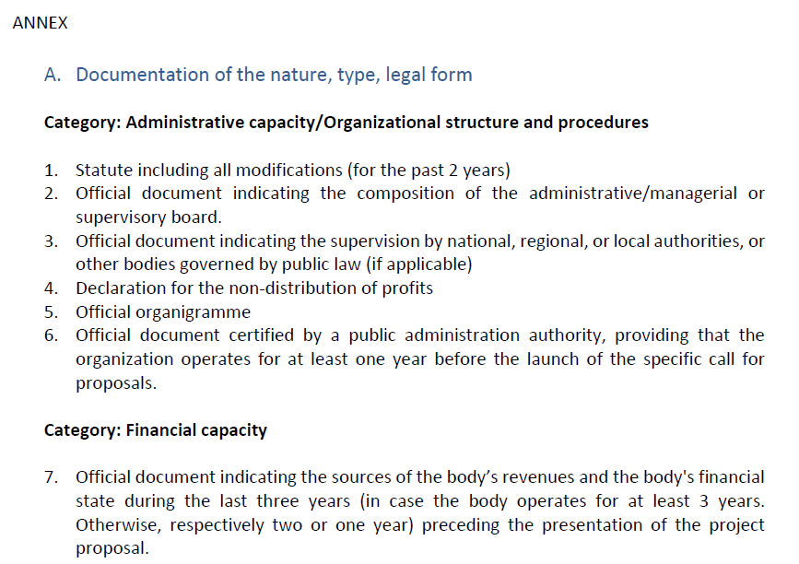
Upload of the mandatory documentation
See more……

Slide 15
Frequently Asked Questions
Returned to Beneficiary & Roles
Change of users
Accounts (Password expire κ.α.)
Technical Issues (Chrome latest version, Clear Cache)

Slide 16
User Support
Annex 16: Guidelines for applying in MIS 2021-2027
ANNEX 17. Technical guidance for Beneficiary User Registration and Account Management
ANNEX 19 Technical guidance of MIS 2021 – 2027
For technical issues mailto: ikalaitzoglou@mou.gr

Slide 17
ΤΗΑΝΚ YOU
IOANNA KALAITZOGLOU
IT Analyst
interreg.gr
ikalaitzoglou@mou.gr
0030 2310 469 671
Λεωφόρος Γεωργικής Σχολής 65, Θεσσαλονίκη 57001

